Slide 1
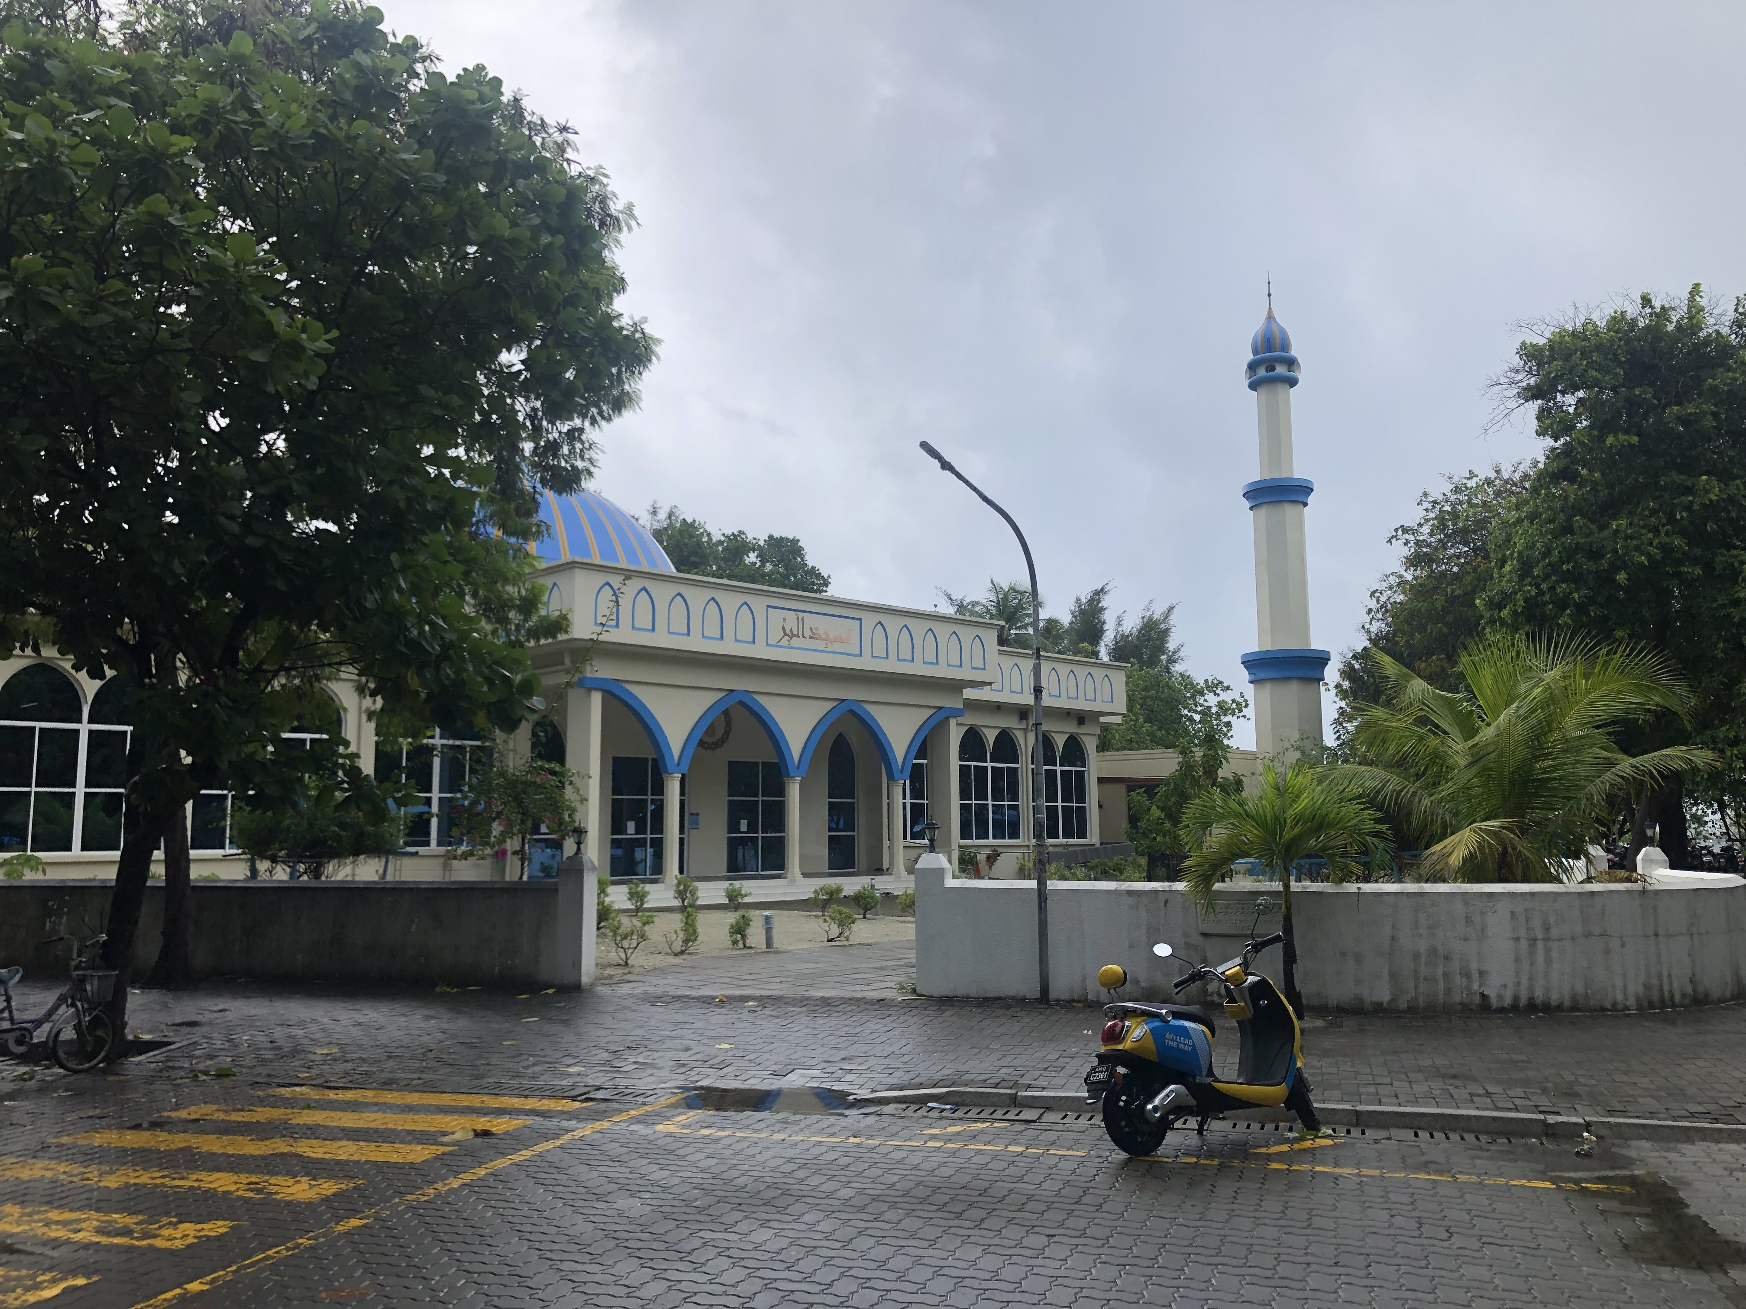
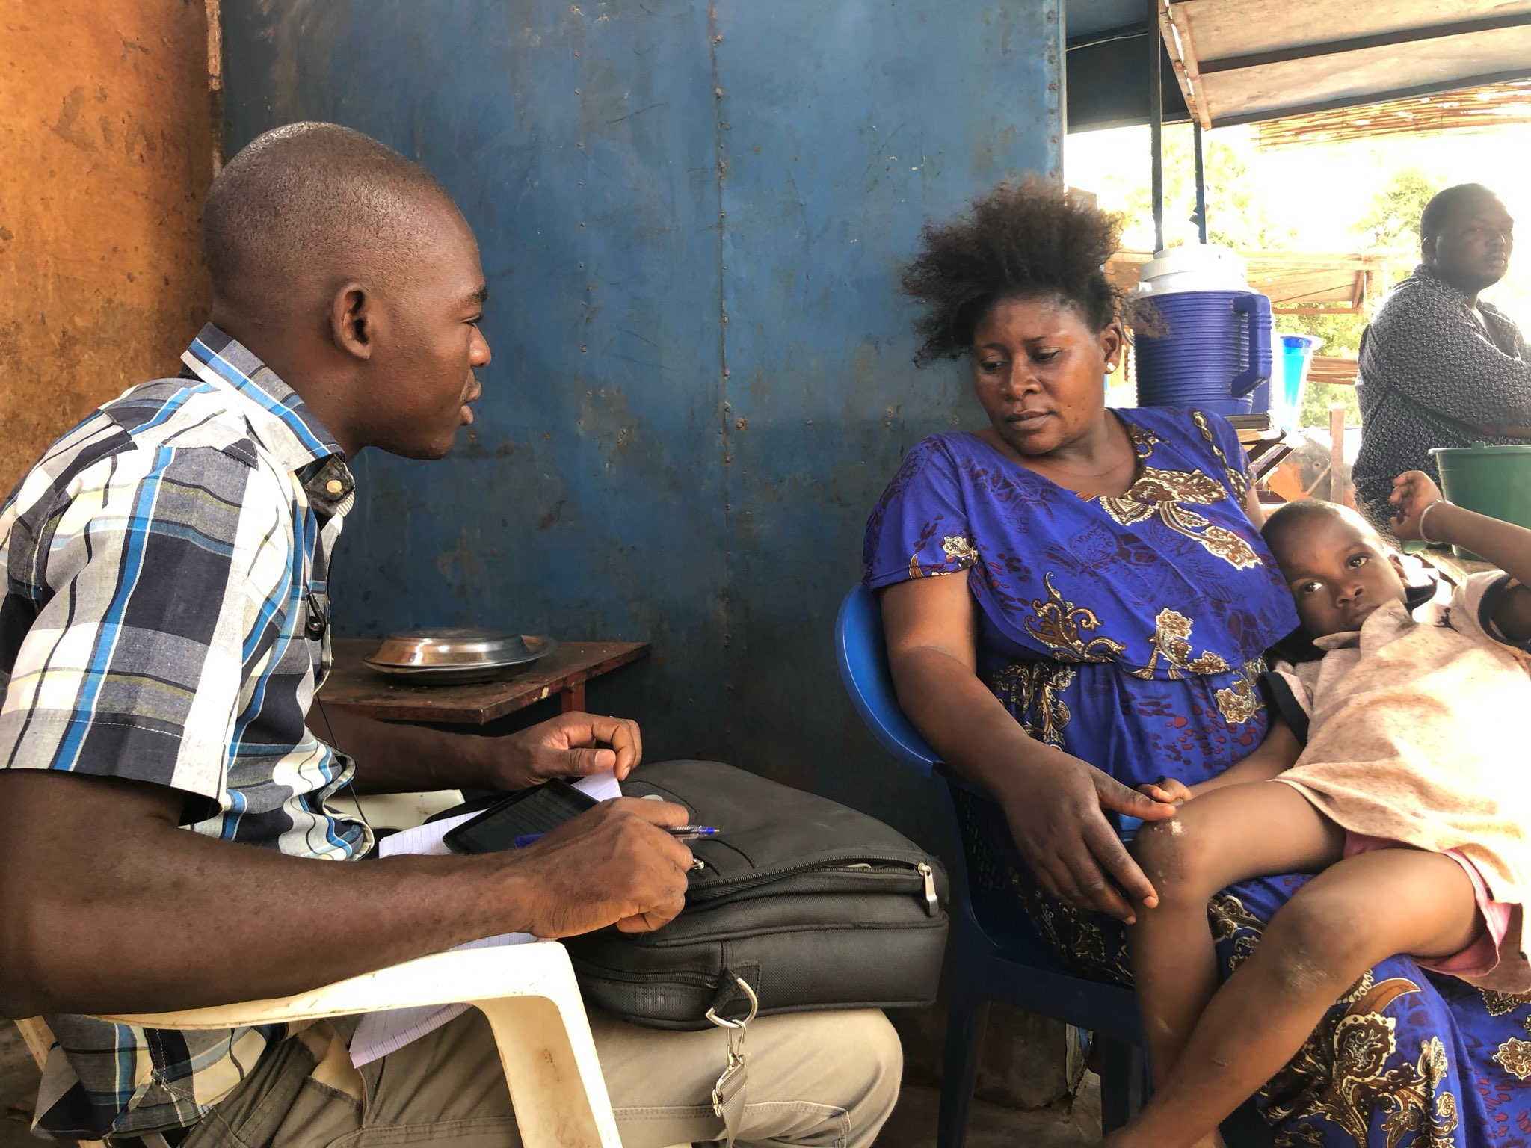
Maldives Security Survey - Topline Findings
October 2022

Slide 2
Preferred security partner
Urbanity
Among the 941 child survey respondents, a plurality of respondents (39%) favor India as their preferred security partner. This preference holds across gender, age, citizenship, education, employment status, and income level.
While a plurality of urban respondents prefer India (27%), they do so at a rate 16 percentage points less than rural respondents, and 12 percentage points less than the national average.
Similarly, a plurality of foreigner workers from Bangladesh prefer India (25%) as their security partner, however this group’s preferences are substantially more heterogeneous than foreign workers from India.
Foreign Worker Country of Origin
OVERALL PREFERENCES FOR A SECURITY PARTNER
India (39%)
China (10%)
The United States (8%)
The United Kingdom (6%)
Other (5%)
2

Slide 3
Youth radicalization as a problem
Gender
Nearly half of respondents (49%) believe that youth radicalization is a problem in Maldives, while 36% believe it’s not an issue, and 15% do not have an opinion.
Perspectives on this topic vary across several demographics. Respondents ages 55 years and older are about 43% more likely to consider than youth radicalization as a problem (70%) in comparison to respondents ages 18-34 (43%) and 35-54 (49%). Additionally, women are about 39% more likely than men to view this as a problem. Further, 70% of unemployed respondents feel like this is an issue, while only 40% of employed respondents feel the same, a difference of about 55%.
49%
Believe that youth radicalization is a problem in the Maldives
Finally, variation persists across formal education level and geographic location. Respondents with no formal education (64%) are more likely than those with formal education or more to perceive youth radicalization as a problem, (53% and 37%, respectively). Geographically, only 34% respondents from the Kaafu atoll find you radicalization as a problem, 39 percentage points less than the average of the other atolls include in the sample.
Is youth radicalization a problem?
Formal Education Level
Atoll
3

Slide 4
Cause of youth radicalization
Forty percent of respondents believe unemployment among youth is the primary cause of youth radicalization, while 26% feel lack of education among youths and 20% think following extremist groups and messaging on social media as the driving cause.
Respondents ages 35 and older differ from respondents ages 18-34 regarding the cause of radicalization. On average, 47% of older respondents feel unemployment as a chief reason for the trend while a third of younger respondents believe the issue stems from unemployment and another third feel the radicalization arises due to lack of education.
Further, disaggregating by subjective income level, respondents who “sometimes go without” are about 20 percentage points less likely to feel that radicalization manifests due to lack of education in comparison to other subjective income groups.
Age Group
Maldives Citizen and Foreign Workers
Lack of Education among Youth as Cause of Youth Radicalization by Subjective Income
4

Slide 5
PREFERRED security partner
Media Source Use
Prevalence of Media Source
Information from friends (88%) and Facebook (84%) are the two most frequent sources of news media among survey respondents. Only about two-thirds of respondents use government media, while 21% follow Times of India and 11% Voice of America.
Maldives citizens and foreign workers consume media in different ways. While the highest frequency of media use between both groups is Facebook – Maldives citizen (79%) and foreign workers (93%) – Maldives citizens (71%), understandably, are 27 percentage points more likely to consume government media than foreign workers (44%). Additionally, foreign workers consume Times of India and Voice of America news at rates higher than Maldives citizens, 14 percentage points and 11 percentage points, respectively.
Age groups also engage with media in different ways. Respondents under age 55 are about 45% more likely to use Facebook and 13% more likely to source information from friends than respondents over age 55. Further, Government media use varies between all three age groups, as 57% of respondents 18-34 consume government media, 66% of respondents 35-54, and 75% of respondents ages 55 and over.
Citizenship
Age Group
5

Slide 6
Media trust index
Media Trust by Urbanity
More respondents source news media from friends and use Facebook than trust those sources. While 88% of respondents receive their information from friends, only 79% of all respondents trust that information. Similarly, while 84% of respondents use Facebook, only 65% of all respondents trust the social media platform for their news. While Times of India and Voice of America have higher rates of trust than use, large shares of respondents (67% and 59%) are plainly unfamiliar with the platform.
Rural respondents are more likely than urban respondents to trust media from the government, Facebook, or friends (8, 12, and 9 percentage points respectively).
Finally, employed respondents trust information from Facebook more than government media by about 7 percentage points, while unemployed respondents prefer the opposite, as they are more likely to trust government media than Facebook by about 13 percentage points.
Media Use vs Media Trust
Media Trust by Employment Status
6

